Slide 1


Graduation Project
Smart Home
Prepared By
Tarek Adel Ali Badee
Anthony Albeir
Abdullah Ismail Abdo
Yahia tarek roushdy

Slide 2
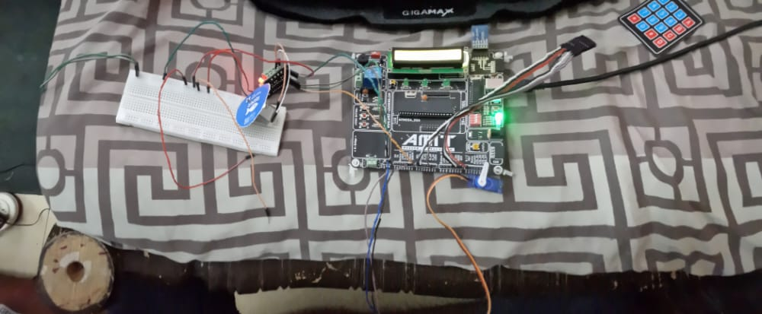
Project

Slide 3

Definition
• it is a popular project nowadays, it is a very comfortable application for humans, it aims to convert any thing around to be controllable and smart.

Slide 4

requirement
❑ Remoted controlled by mobile or lab top.
❑ The controllable things are 6 lamps “5 on/off lamps, one dimming lamp”, door, air-condition according to the ambient temperature.
❑ Login system admin and user “admin is remoted only”.

Slide 5
❑ Usernames and password must be kept into memory even if the system is powered off.
❑ If admin or any user or passwords are entered wrong more than 3 trial, the system must break down and fire alarm until reset.
❑ Admin and user can access to all applies except user cannot control the door opening.

Slide 6
LCD
keypad
EEPROM
Bluetooth
LEDs
Temperature Sensor
DC motor
Motor Driver
Servo Motor
Jumpers
Breadboard
What we used in our code
Notes:
RCNN The Region-based Convolutional Network method (RCNN) is a combination of region proposals with Convolution Neural Networks (CNNs). R-CNN helps in localising objects with a deep network and training a high-capacity model with only a small quantity of annotated detection.
Fast Region-Based Convolutional Network method or Fast R-CNN is a training algorithm for object detection. This algorithm mainly fixes the disadvantages of R-CNN, while improving on their speed and accuracy.
Faster R-CNN is an object detection algorithm that is similar to R-CNN. This algorithm utilises the Region Proposal Network (RPN) that shares full-image convolutional features with the detection network in a cost-effective manner than R-CNN and Fast R-CNN
Region-based Fully Convolutional Networks or R-FCN is a region-based detector for object detection. Unlike other region-based detectors that apply a costly per-region subnetwork such as Fast R-CNN or Faster R-CNN, this region-based detector is fully convolutional with almost all computation shared on the entire image.

Slide 7
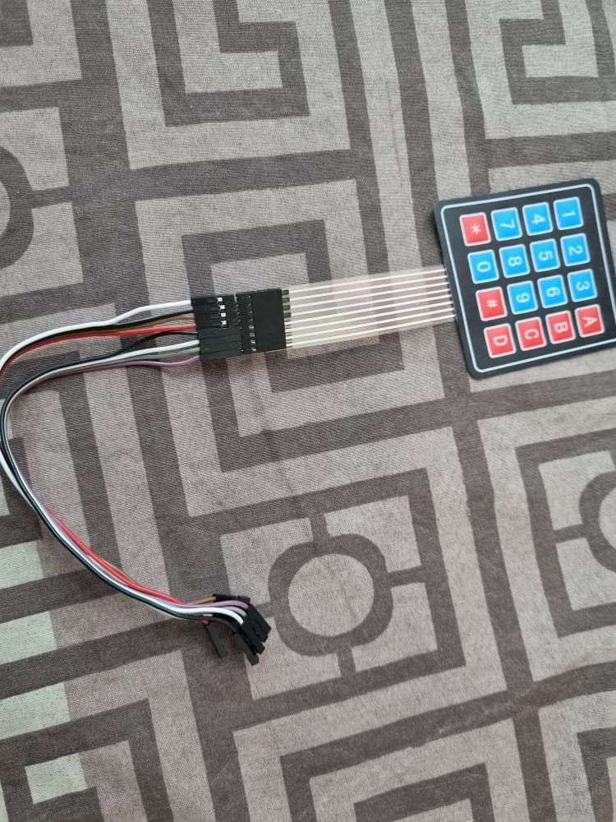
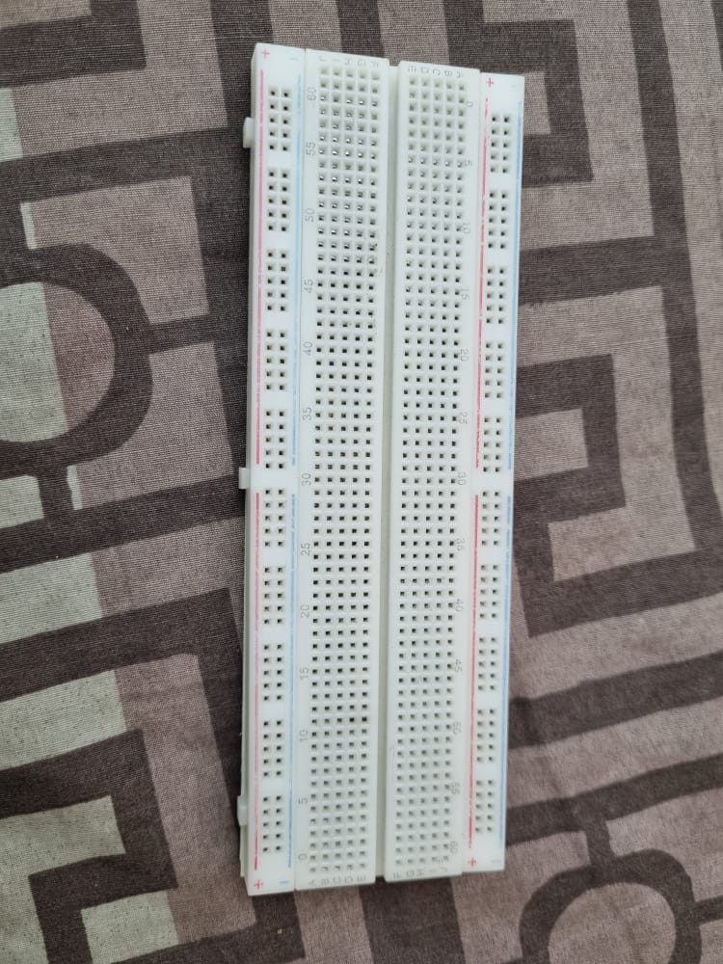
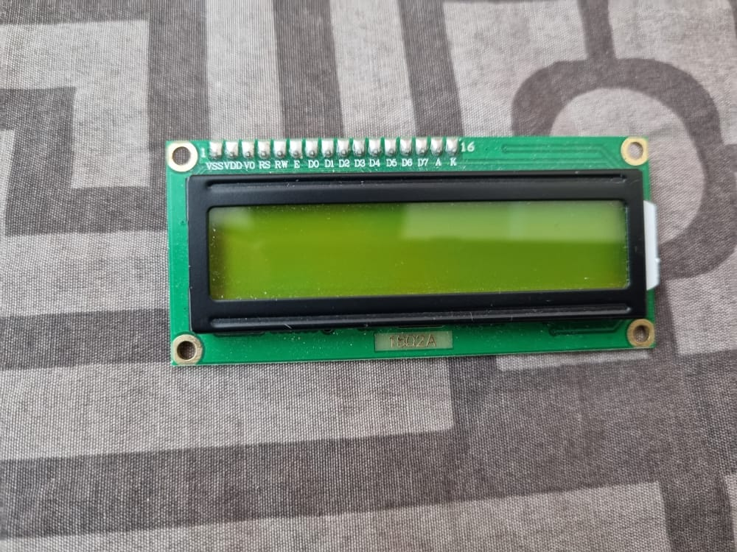
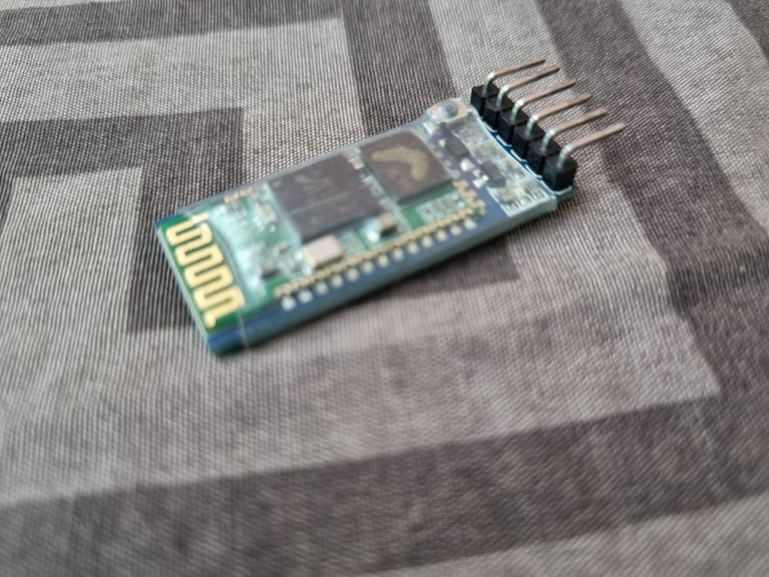
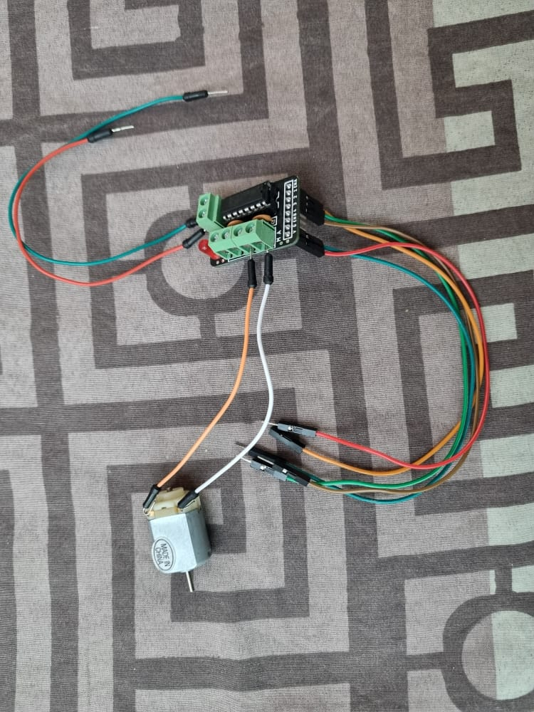
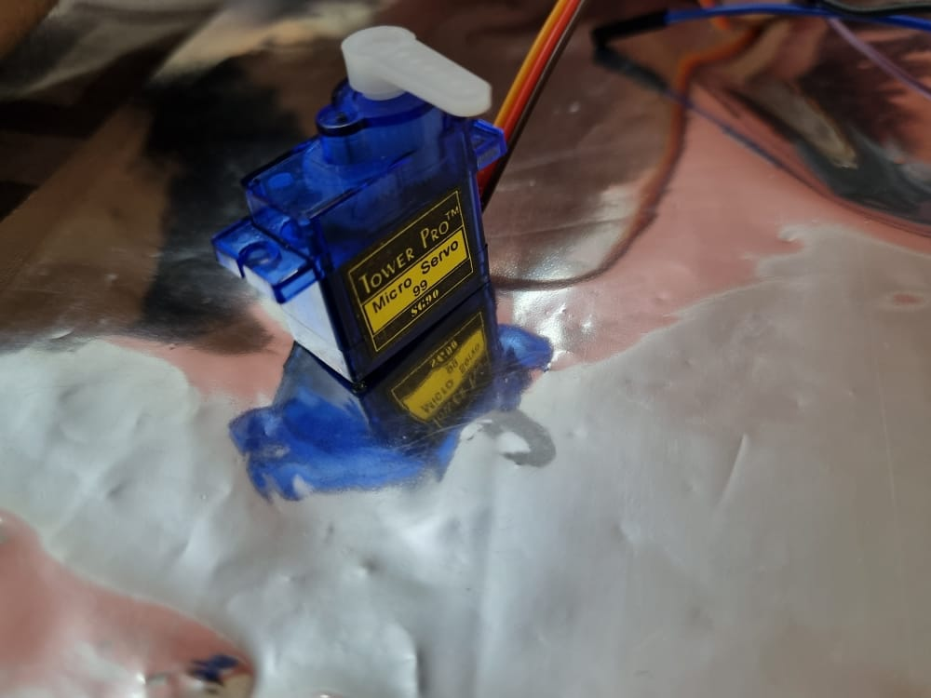

Slide 8
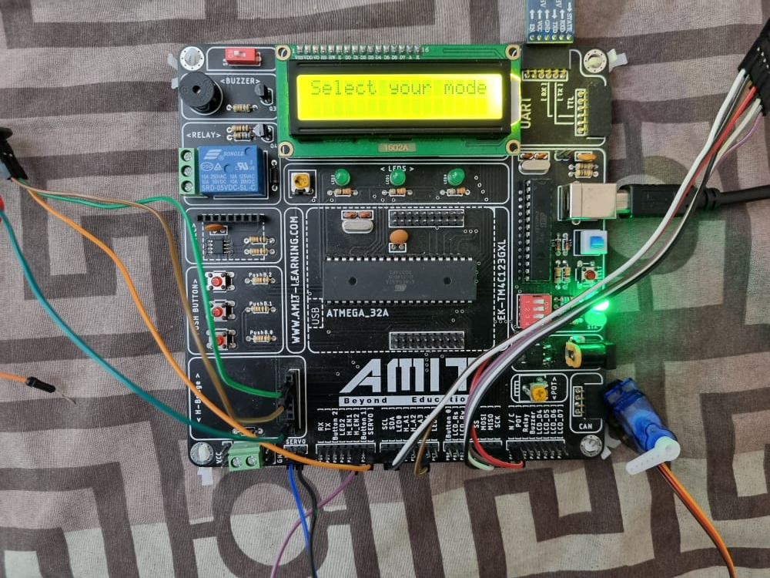
Selcet Mode

Slide 9
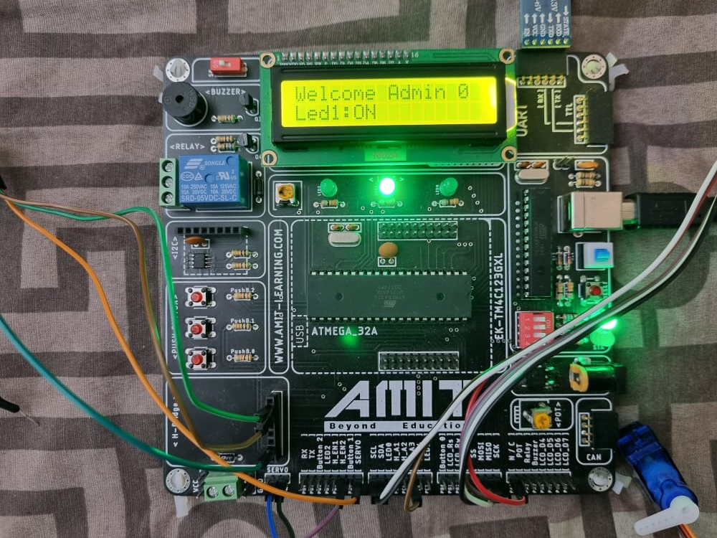
Admin Mode

Slide 10
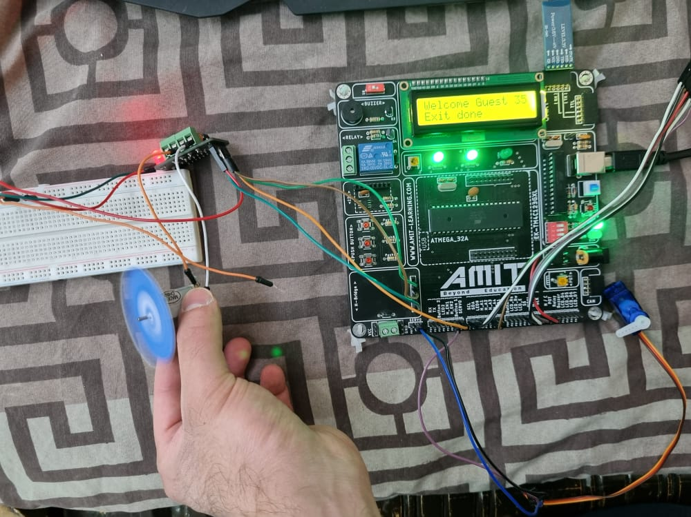
Guest Mode

Slide 11
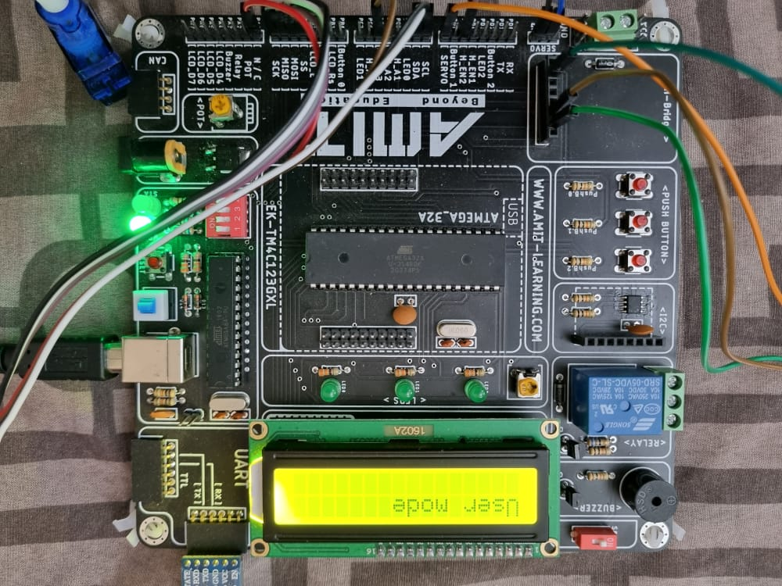
Keypad Mode

Slide 12
What we Face in code problems
How to make Bluetooth receive string
Using DC motor & Servo
Make home response
Checking the temp to use Fane or AC
Choosing right pins to avoid interfacing between sharing components
Using timers in right ways
Using EEPROM to store and read data from it

Slide 13
Tasks
Anthony (Led & buzzer &Button drivers)
Yahia (keypad & temp drivers)
Abdullah (DC motor & EEPROM & Servo drivers )
Tarek (Bluetooth & Dimmer & LCD & Implementing project in main.c )

Slide 14

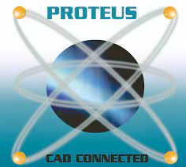
Software App
Notes:
In this section, the operating system and the software programming for controlling the sensors and the image processing will be shown as follows.
Raspbian is the official distribution of Raspberry Pi. Based on Debian
Opencv is an opensource library for image processing in which it is free and customized with large number of commands and can be integrated in c language and python language.
Tensorflow is a library that can be used for training the dataset using the previous object detection nural network and can be added as library for detection in c and python language.

Slide 15
Thank You

